Slide 2


REAL-TIME CHAT
With NODEJS AND SOCKET IO
Presented By:-
KULDEEP MAURYA (0199AL201022)
Technocrats Institute of Technology-Bhopal

Slide 3
Content
Introduction
Objectives
Front End View
Software/Modules Requirement
Hardware Requirement
Diagrams
Activity Diagram
Sequence Diagram
Component Diagram

Slide 4
Introduction
Real-time chat is virtually any online communication that provides a real-time or live transmission of text messages from sender to receiver. A variety of software programs are available to enable real-time chat between individuals using Internet services.
This project is aimed at developing a real-time chat application that enables users to communicate with each other in real-time. The application will use Node.js, Passport.js, MongoDB, Socket.io, HTML, and CSS technologies. The application will enable users to create accounts, log in, and start chatting with other users. Users will be able to send text messages to each other.

Slide 5
Objectives
Develop a user-friendly and efficient virtual Real time Chat-App.
Enable real-time communication between users.
Implement user authentication using Passport.js.
Store a history of Login users.
Display number of online users to all users.
Allow users to create profiles and personalize them.

Slide 6






Software/Modules Requirements
Operating System:- Windows 10
Language:- JAVASCRIPT
NODEJS
FRONT-END
HTML
CSS
JS
Gsap
BACK-END
EXPRESSJS
SOCKET IO
PASSPORTJS
MONGODB
Web Browser

Slide 7
Diagrams-
Create your new Account
2. Sequence Diagram
False
Create new account or Login
Login by username and password
Match Username and password
True
Delete
Profile
Enter Delete button for delete your account
Start conversation
ALL Users
Start Chat
Back to profile
Start conversation

Slide 8
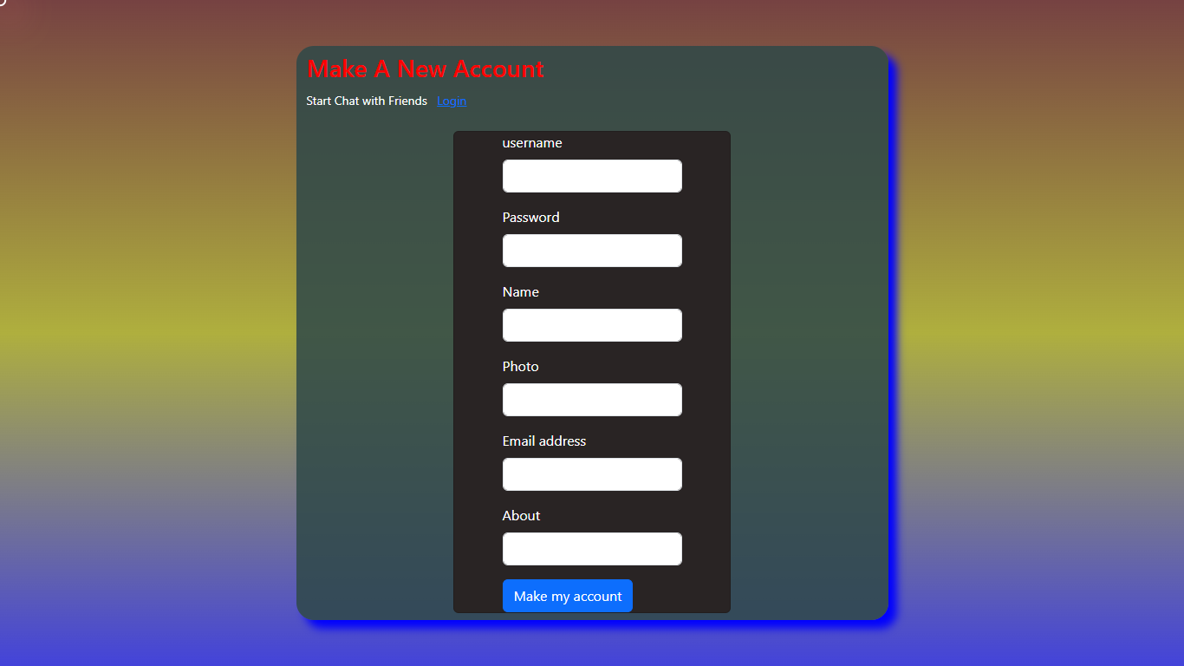
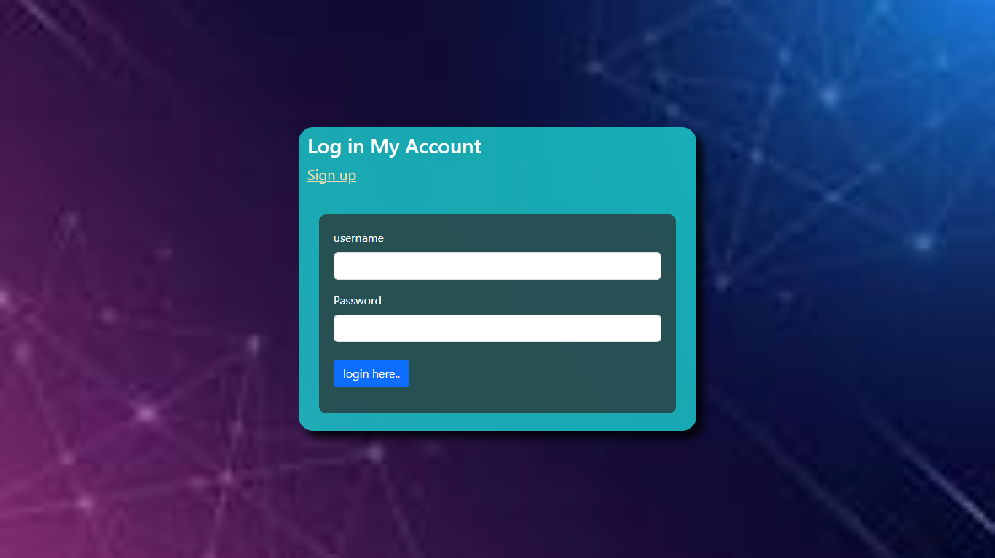
USER INTERFACE
Login and Signup page
SIGNUP
Enter Name, Username , Password, Profile Photo , Email, About Yourself
Login
WITH USERNAME AND PASSWORD

Slide 9
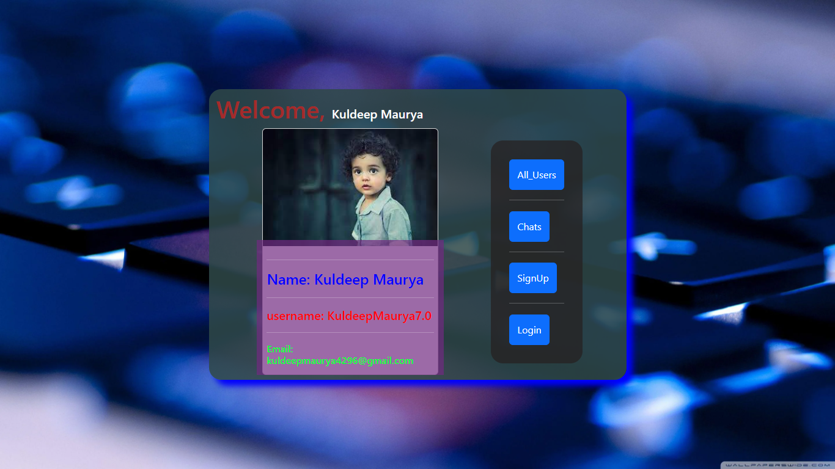
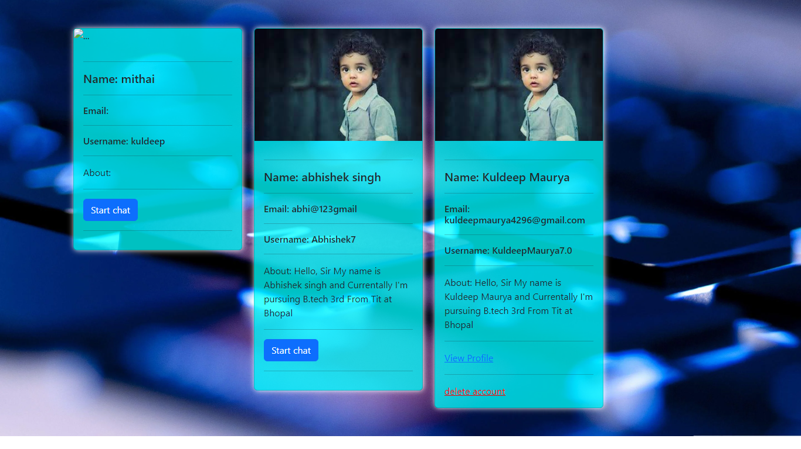
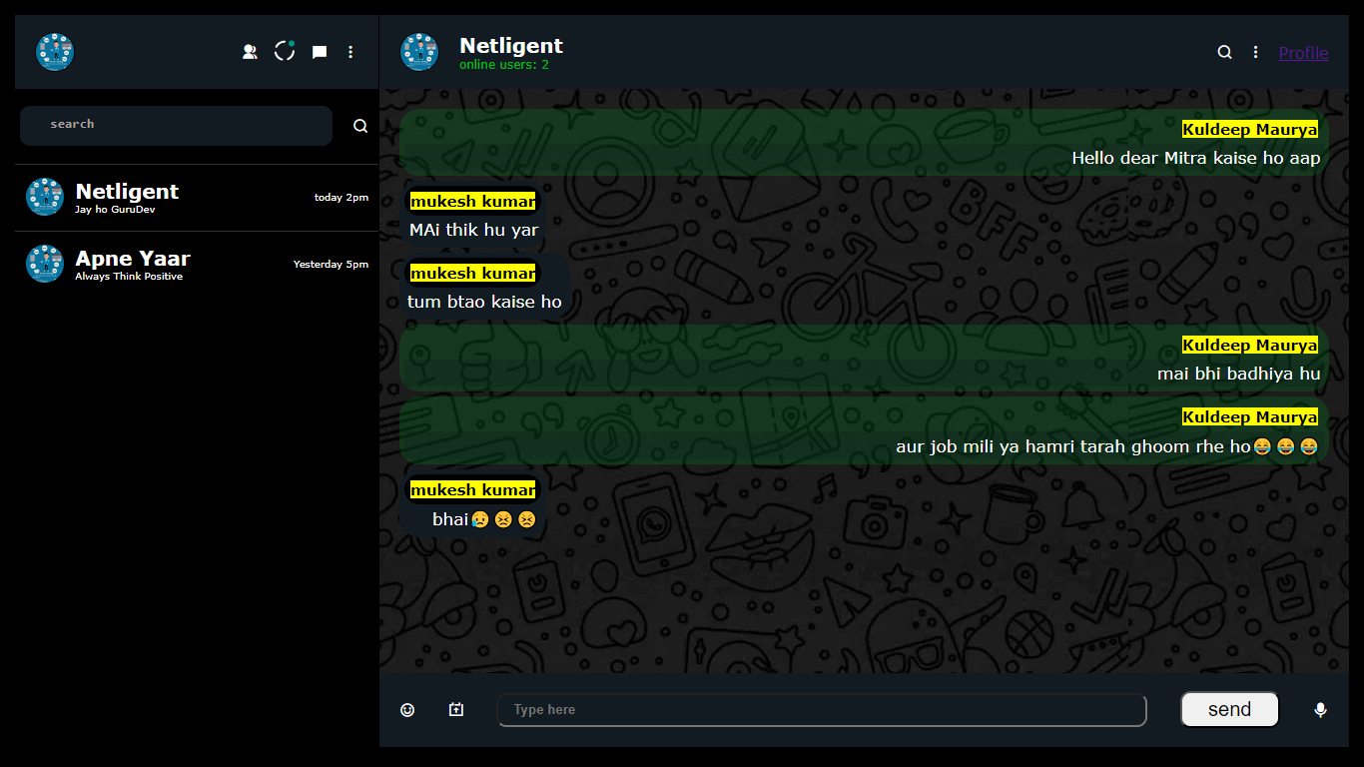
USER INTERFACE
User Profile and All users page
User Profile
In this section we can easily start conversation , see user profile and delete yourself in a single click
Show all users
Click for Start chat
Delete user

Slide 10
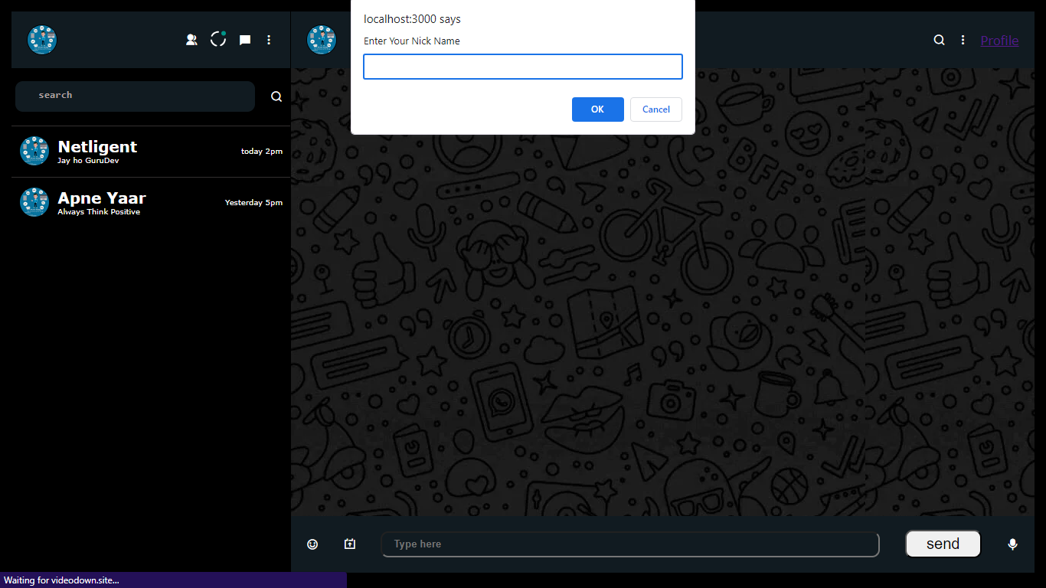
USER INTERFACE
Conversation page
Start Conversation
Enter Your Nick name

Slide 11
RUNNING FEATURES
USER MANAGEMENT
Chat Features
Profile Management
Show Profile
All Users' Profiles
Create User
Login User
Delete User
Chat Online with Logged-in User
Send and Receive Messages

Slide 12
FUTURE FEATURES
GROUP MANAGEMENT
USER INTRACTION
ADVANCED COMMUNICATION
Create Group
Chat One to One
Chat Online with Logged-in User
Send and Receive Messages
VIDEO CALL
Documents Upload and Download in chat Box

Slide 13
THANK YOU

Slide 14
HARDWARE REQUIREMENT
Processor:- i3 4th gen 64bit
Graphics Card- RTX 1050 ti (Optional)
Ram:- Minimum 4gb
Microphone (optional)

Slide 15
Challenges Faced
Discuss any challenges you encountered during development and how you overcame them.
Highlight problem-solving skills.

Slide 16
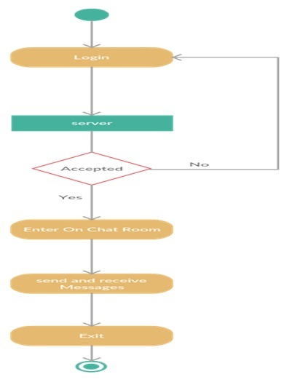
Diagrams-
Activity Diagram

Slide 17
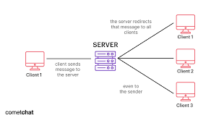
Diagrams-

